Slide 1
Unit04
Nutrition for
Physical Performance

Slide 2
Unit aims
You will explore the importance of nutrition and hydration within a sport context
Learning aims
In this unit you will:
Examine concepts of nutrition, hydration, diet and digestion
Explore energy intake and expenditure for sports and physical activity
Investigate legislation, guidance and procedures associated with anti-doping
Produce a diet and hydration plan to support a selected sport or physical activity

Slide 3
A1: nutrition
Structures, function and sources Macronutrients: Carbohydrates
Carbohydrates are a type of macronutrient found
in many foods and drinks. Most occur naturally in
plant-based foods, such as grains and potatoes.
They are also found in processed foods such as
pasta and bread.
Sugars and starches:
Sugars are simple carbohydrates and starches are
complex. Carbohydrates are stored in the body as starches. They provide energy for the brain and other body systems. During sport they provide energy using both the aerobic and anaerobic systems.
Simple Carbohydrates:
Are absorbed in the body quickly
Increase blood sugar level quickly
Complex Carbohydrates:
Are absorbed slowly
Increase blood sugar level slowly
Monosaccharides: The simplest types of sugar molecule, e.g. glucose and fructose.
Disaccharides: Two monosaccharides (sugar molecules) linked together, e.g. sucrose and lactose.
Polysaccharides: A large number of monosaccharides
(sugar molecules) linked together e.g. starch and glycogen.

Slide 4
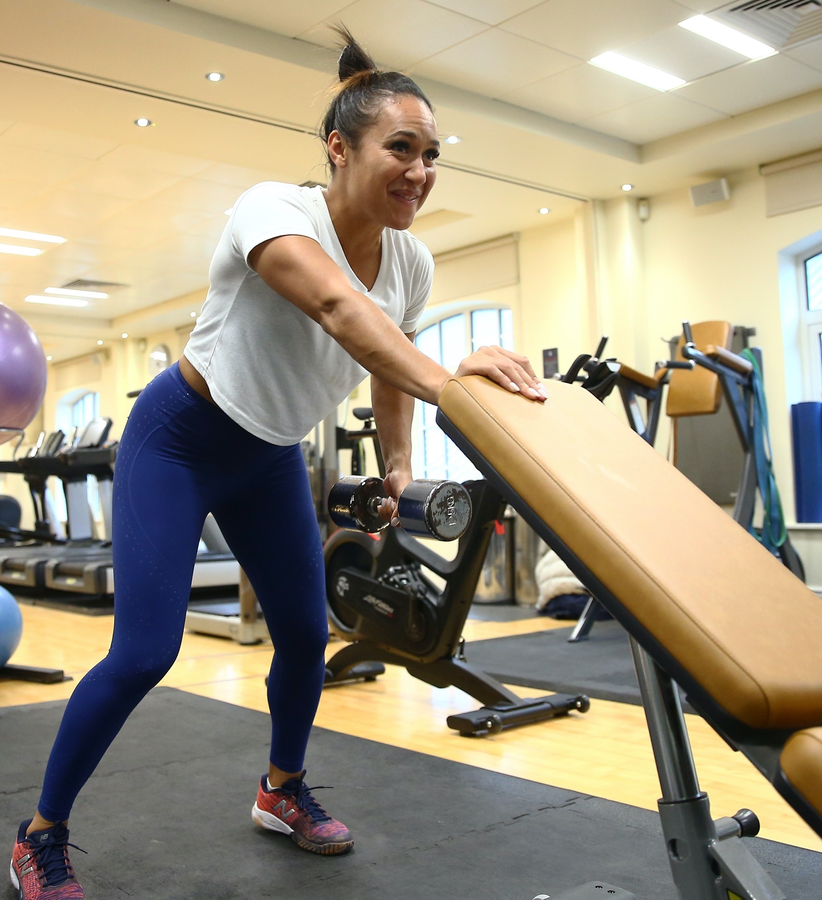
A1: nutrition
Structures, function and
sources Macronutrients:
proteins
Protein helps your body to grow and repair, it allows metabolic reactions to take place and can be used as an energy source.
It can be found in meat, poultry, seafood, eggs and dairy products, seeds, nuts, peas and beans.
Amino acids:
There are 20 different types of amino acids that can be combined to make a protein.
How much protein do you eat? Which sources of protein do you mostly consume? | ?

Slide 5
A1: nutrition
Structures, function and sources Macronutrients:
fats
Fats provide a source of fuel for your body, support
cell growth, keep us warm and protect organs.
Saturated:
Chains of fatty acids with single bonds. Found in animal products like milk, cheese, and meat, as well as tropical oils, including coconut and palm oil.
Unsaturated (monounsaturated, polyunsaturated):
Chains of fatty acids with double bonds. Found in avocadoes, olives, fatty fish and nuts.
Hydrogenated fats and trans fats:
Man made fats produced by adding hydrogen to polyunsaturated fatty acids to allow them to last for
longer and keep them solid at room temperature.
Found in margarine, fast foods, commercial baked
goods, processed and fried foods.
Fatty acids (omega 3 and omega 6):
Polyunsaturated fats which the body uses to maintain
brain and nervous system function, as well as building
healthy cells. Found in plant oils, seeds, and nuts.

Slide 6
A1: nutrition
Structures, function and sources Macronutrients:
vitamins & Minerals
Vitamins:
Vitamins allows your body to grow and develop.
They help in bodily functions such as metabolism, immunity, and digestion. Sources of vitamins are fresh
fruit and vegetables, meat, fish and dairy products.
Your body needs 13 vitamins: A, C, D, E, K and the B
vitamins (thiamine, riboflavin, niacin, pantothenic acid,
biotin, vitamin B-6, vitamin B-12 and folate).
You can usually get all your vitamins from the foods you eat. Some vitamins are soluble (dissolve) in water and some are soluble in fats.
Minerals:
Essential substances that our bodies need
to develop and function normally.
Including: calcium, potassium, sodium, phosphorus, magnesium, chloride, and sulphur. They are essential
nutrients found in many plant and animal-based foods.

Slide 7
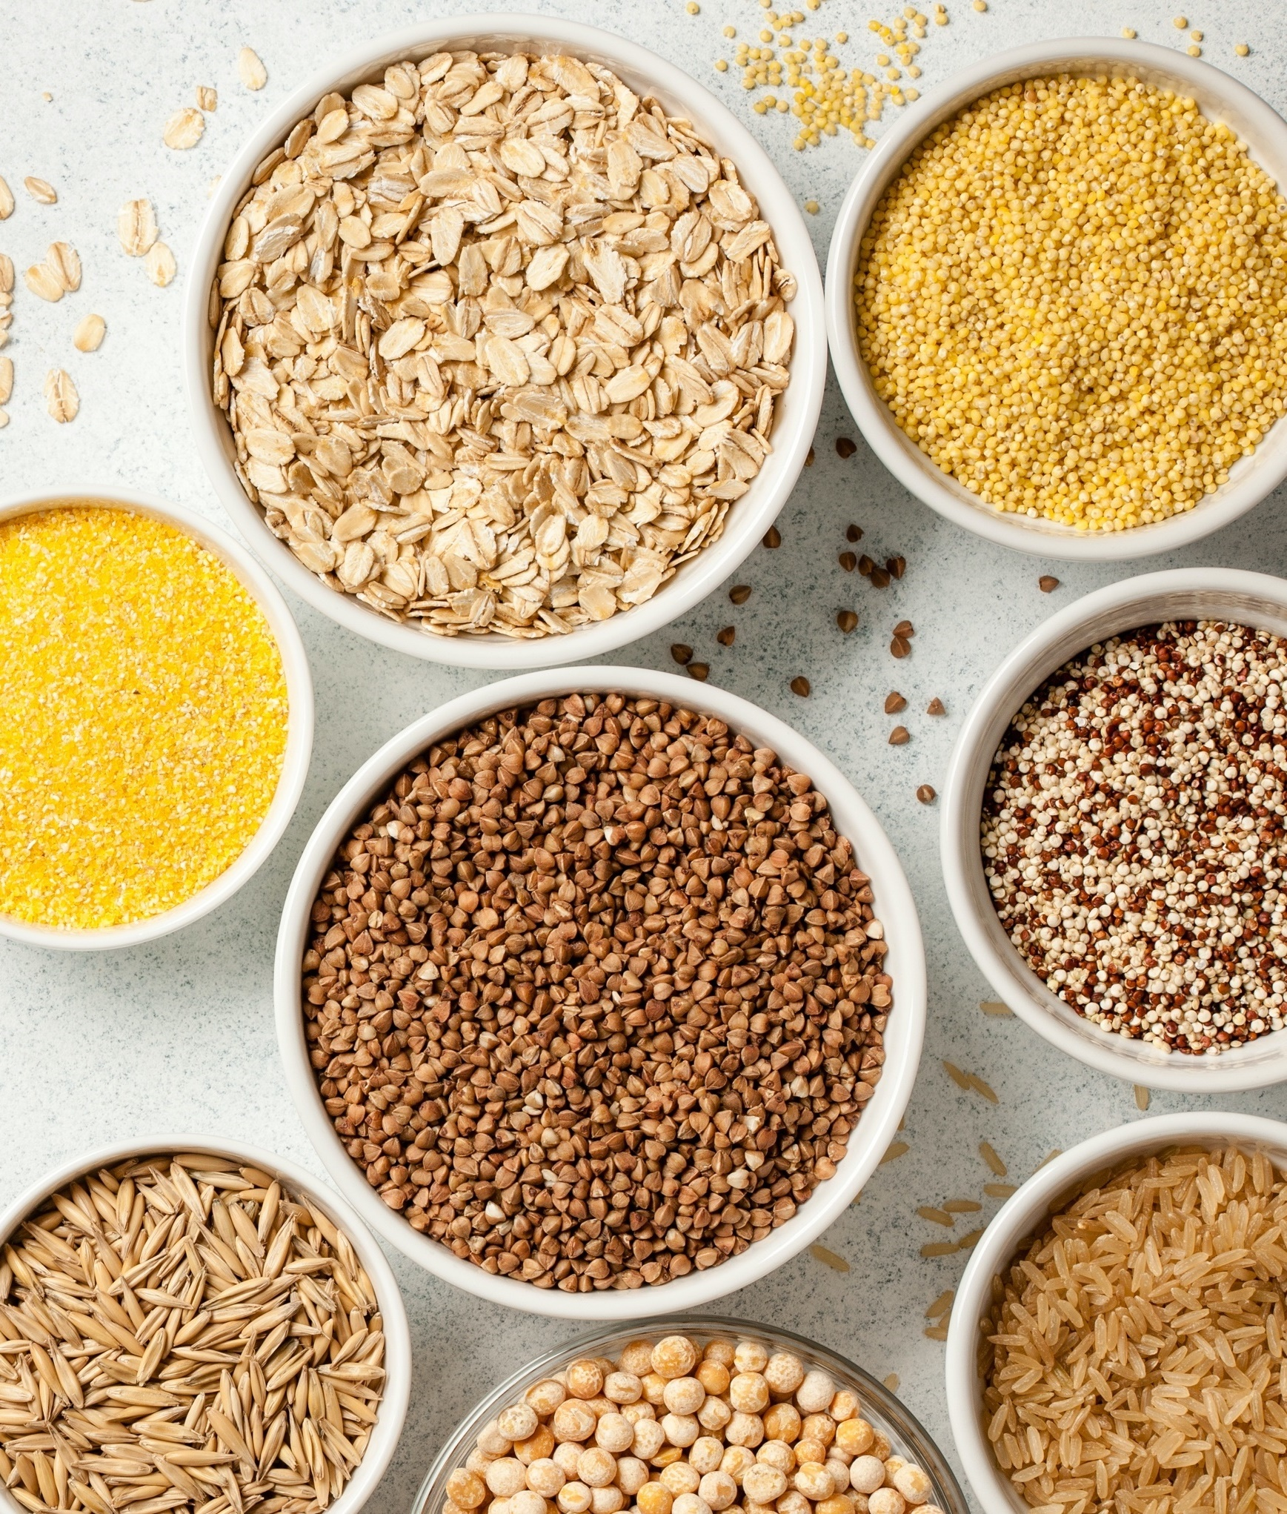
A1: nutrition
Structures, function and sources Macronutrients:
fibre
There are two types of fibre:
Soluble (which dissolves in water) it can help lower glucose levels as well as help lower blood cholesterol.
Insoluble (which does not dissolve in water) it helps food move through your digestive system.
Sources of fibre include:
Breads, crackers, pasta and cereals made from
whole grains. Wheat and oat bran have the highest content of fibre.

Slide 8

A1: nutrition
nutritional requirements
Essential nutrients are nutrients the body cannot make itself, or not as much as we need. The body needs these nutrients to perform it’s basic functions.
There are six basic essential nutrients.
These are protein, minerals, fat, vitamins, carbohydrates, and water, more specifically:
Amino Acids: Leucine, Valine, Arginine
Vitamins: A, B6, D, C, B12
Minerals: Iron, Potassium, Calcium,
Sodium, Chloride
Fresh fruit and vegetables are rich in essential nutrients. You can also get essential nutrients through vitamin and mineral supplements.
Non essential nutrients are made in the body. They can be absorbed through certain foods. They are important in maintaining health.
Most vitamins are considered essential nutrients. Vitamin D is produced from exposure to ultraviolet rays from the sun and has an important role in bone health and calcium absorption.

Slide 9
A1: nutrition
common terminology and standard abbreviations
Recommended Daily
Allowance (RDA)
Reference Daily
Intake (RDI)
Optimum Daily
Intake (ODI)
Safe Intake (SI)
Estimated Average Requirements (EAR)
Identify the RDA, RDI, ODI, SI, EAR of different nutrients and food groups by looking at a range of food packets | !

Slide 10
A2: hydration
signs & symptoms
Give a definition for the following:
dehydration
hyperhydration
hypohydration
superhydration
What are the common signs and symptoms of each of the above terms? | ?
Why is it important for a tennis player and their coach to know the common signs and symptoms of each? | ?

Slide 11
A2: hydration
Fluid intake & Sources
Fluid intake
Fluid intake demands vary at different times in an event:
Pre-event - before the activity, competition or training session
Inter-event - during, as the activity takes place
Post-event - after the activity has finished
Why is it important for a tennis player to maintain correct hydration during the three different stages? | ?

Slide 12
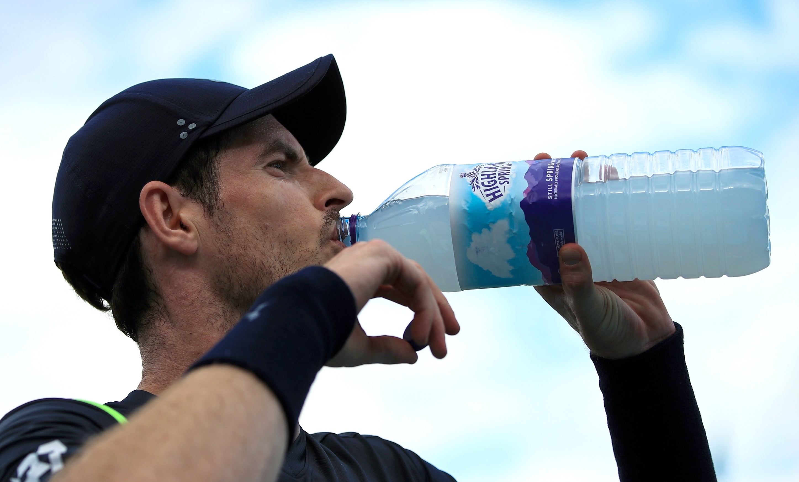
A2: hydration
Fluid Sources
What sources of fluid can a tennis
player use to keep hydrated?
Water and sports drinks:
Hypertonic
Hypotonic
Isotonic
What is the difference between hypertonic, hypotonic and isotonic? | ?

Slide 13
A3: diet
Balanced diet
?
What makes a balanced diet?
Think about what you ate yesterday…
Did you have a balanced diet?
Were there any food groups you had too
much of or not enough?
Did you eat enough fibre?
Where did your micronutrients come from?
Carbohydrates
Fats
Proteins
Water
Fibre
Vitamins
Minerals

Slide 14
A3: diet
Influence of nutrition on health
Obesity
The medical condition of being grossly overweight
Cholesterol
Caused by a diet high in fat Can lead to heart disease
Cancer risk
30% of all cancer cases are thought to be linked to poor diet
Heart disease
Half of deaths from heart disease, diabetes, stroke can be linked to poor diet
Which other illnesses and diseases can be influenced by poor nutrition? | ?

Slide 15
A3: diet
Guides for sources of nutrition and balanced diets and evidence-based recommendations
government guidelines
credible sources
eatwell plate
food pyramid
food labelling
Why is it important to use evidence based and reliable sources of information to be able to give accurate nutritional advice? | ?

Slide 16
A4: digestion
The structures of the digestive system
Label the diagram with the following structures:
Tongue
Salivary glands
Liver
Pancreas
Gallbladder
Gastrointestinal tract
Buccal cavity
Oesophagus
Stomach
Small intestine
Large intestine
What is the role function of each structure? What is the role of digestive juices and enzymes in the digestive process? | ?

Slide 17
A4: digestion
Functions of the
digestive system
Digestion
Your digestive system breaks nutrients into smaller parts which your body can absorb and use for energy, growth and cell repair.
absorption
Nutrients are absorbed in the digestive tract this allows them to be used by all cells in the body and for metabolism.
Excretion
After food has been digested
and absorbed. Waste is removed from the body. Waste is made up of anything the body cannot use and absorb.

Slide 18
B1: energy
measures & Sources
Energy Measures
Calories
Joules
Kilocalories
Kilojoules
Sources of energy
Fats
Carbohydrates
Proteins
Collect a range of different food packaging Examine the energy measure on the packaging Which measurements are commonly used? Which sources of energy are commonly displayed on food packaging? | !

Slide 19
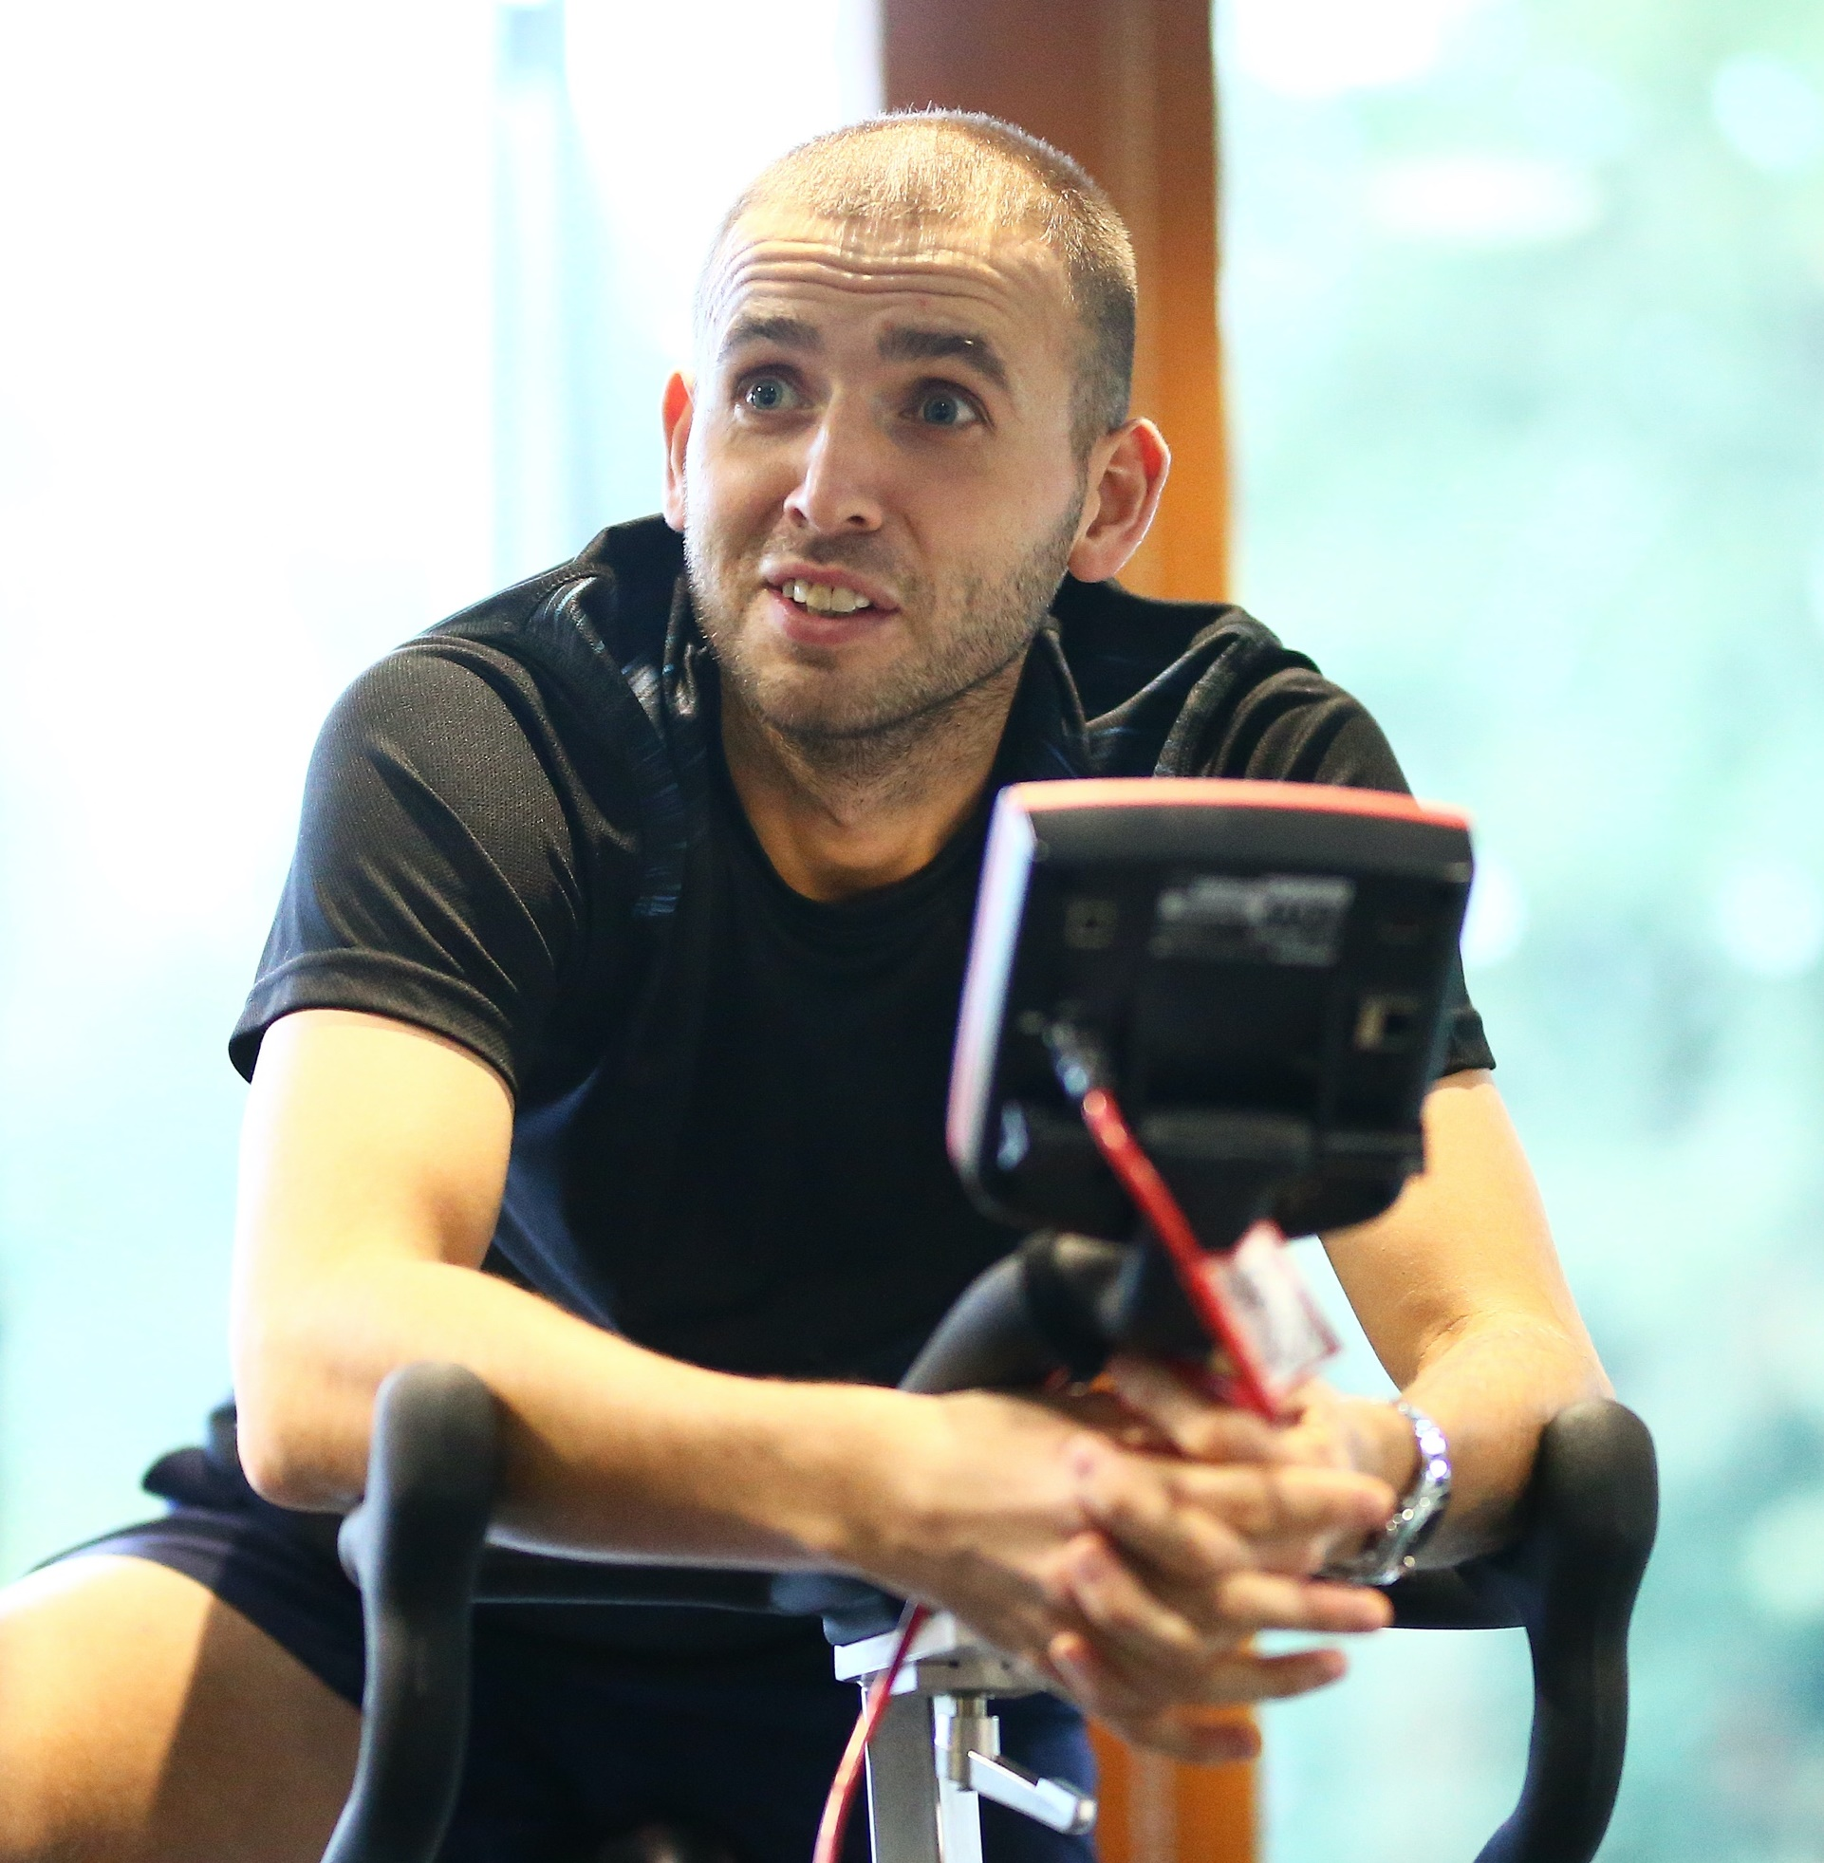
B1: Energy
Measuring requirements and body weight
Measuring requirements
Common measurements are taken so that exact comparisons can be made.
Body composition, lean body mass and percentage body fat are all ways to measure a persons body
Skinfold analyses, bioelectrical impedance analysis and hydrodensitometry can be used to accurately measure a persons body composition
Body weight and calorimetry (direct and indirect) can also be used to give an indication of
body composition

Slide 20






B2: energy balance
Factors effecting energy balance
climate
Physical activity
Basal
metabolism
age
gender
Energy balance is a state where the amount of energy you eat equals the amount of energy you use
Energy in = energy out
What happens if energy in is higher than energy out? You eat more energy than you use? | ?
How is energy balance affected by climate, basal metabolism, physical activity, age and gender? | ?

Slide 21




c1: Performance enhancing substances and drugs
anti-doping
Anti-doping
Opposing or prohibiting illegal doping
to improve athletic performance.
Support personnel, coaches, sport science
staff, nutritionists, parents all play a role in preventing doping and monitoring performers intake of substances.
Global organisation that coordinates anti-doping around the world
The national organisation responsible for anti-doping in the UKAD
Safeguards the integrity of professional tennis worldwide
The national organisation for tennis in Britain

Slide 22
c1: Performance enhancing substances and drugs
world ant-doping agency (WADA)
The World Anti-Doping Agency's mission is to lead a collaborative worldwide movement for doping-free sport.
WADA was founded with the aim of bringing consistency to anti-doping policies and regulations within sport organizations and governments right across the world.
Since 2004 WADA prohibited has published an annual list of Prohibited Substances and Methods.
The substances and methods on the list are classified by different categories e.g. steroids, stimulants, gene doping.
WADA work alongside governments and sports organisations to establish a monitoring program to look at substances which are not on the Prohibited List, but WADA wants to monitor in order to detect patterns of misuse in sport.

Slide 23
c1: Performance enhancing substances and drugs
wada prohibited list
Prohibited at all times
(in and out-of-competition):
Prohibited substances
Non-approved substances
Anabolic agents
Peptide hormones, growth factors,
related substances, and mimetics
Beta-2 agonists
Hormone and metabolic modulators
Diuretics and masking agents
Prohibited in competition:
Stimulants (non-specified
and specified)
Narcotics
Cannabinoids
Glucocorticoids
Prohibited in particular sports:
Beta blockers
Research the different types of banned substances relevant to tennis, both in and out of competition | ?

Slide 24
c2: Anti-doping
legislation and guidance
agencies and policing
of anti-doping
?
Agencies and policing of anti-doping:
World Anti-Doping Agency (WADA)
UK Anti-Doping (UKAD)
Sports Federations: e.g. International Tennis Integrity Agency (ITIA) and the LTA
What are the roles and responsibilities of WADA, UKAD and the ITIA / LTA?
How do anti-doping rules and guidance help to prevent doping in sport?
Carry out research to identify rules and guidance relevant to doping in tennis.

Slide 25
c2: Anti-doping
legislation and guidance
Athlete’s rights and responsibilities
Athletes need to be aware of the prohibited list for their sport, both during competition and in training.
Strict Liability:
Players are responsible for all substances that they
put inside their body and it is their responsibility to ensure they are not taking any prohibited substances, even unintentionally such as through diet, nutritional supplements or medications.
Medications and nutritional supplements
can contain prohibited substances.
Players may require permission to use
certain medications.
Supplements can:
Contain prohibited substances
Be contaminated
Be counterfeit
Players are recommended to follow a
‘food first’ approach to nutrition.

Slide 26
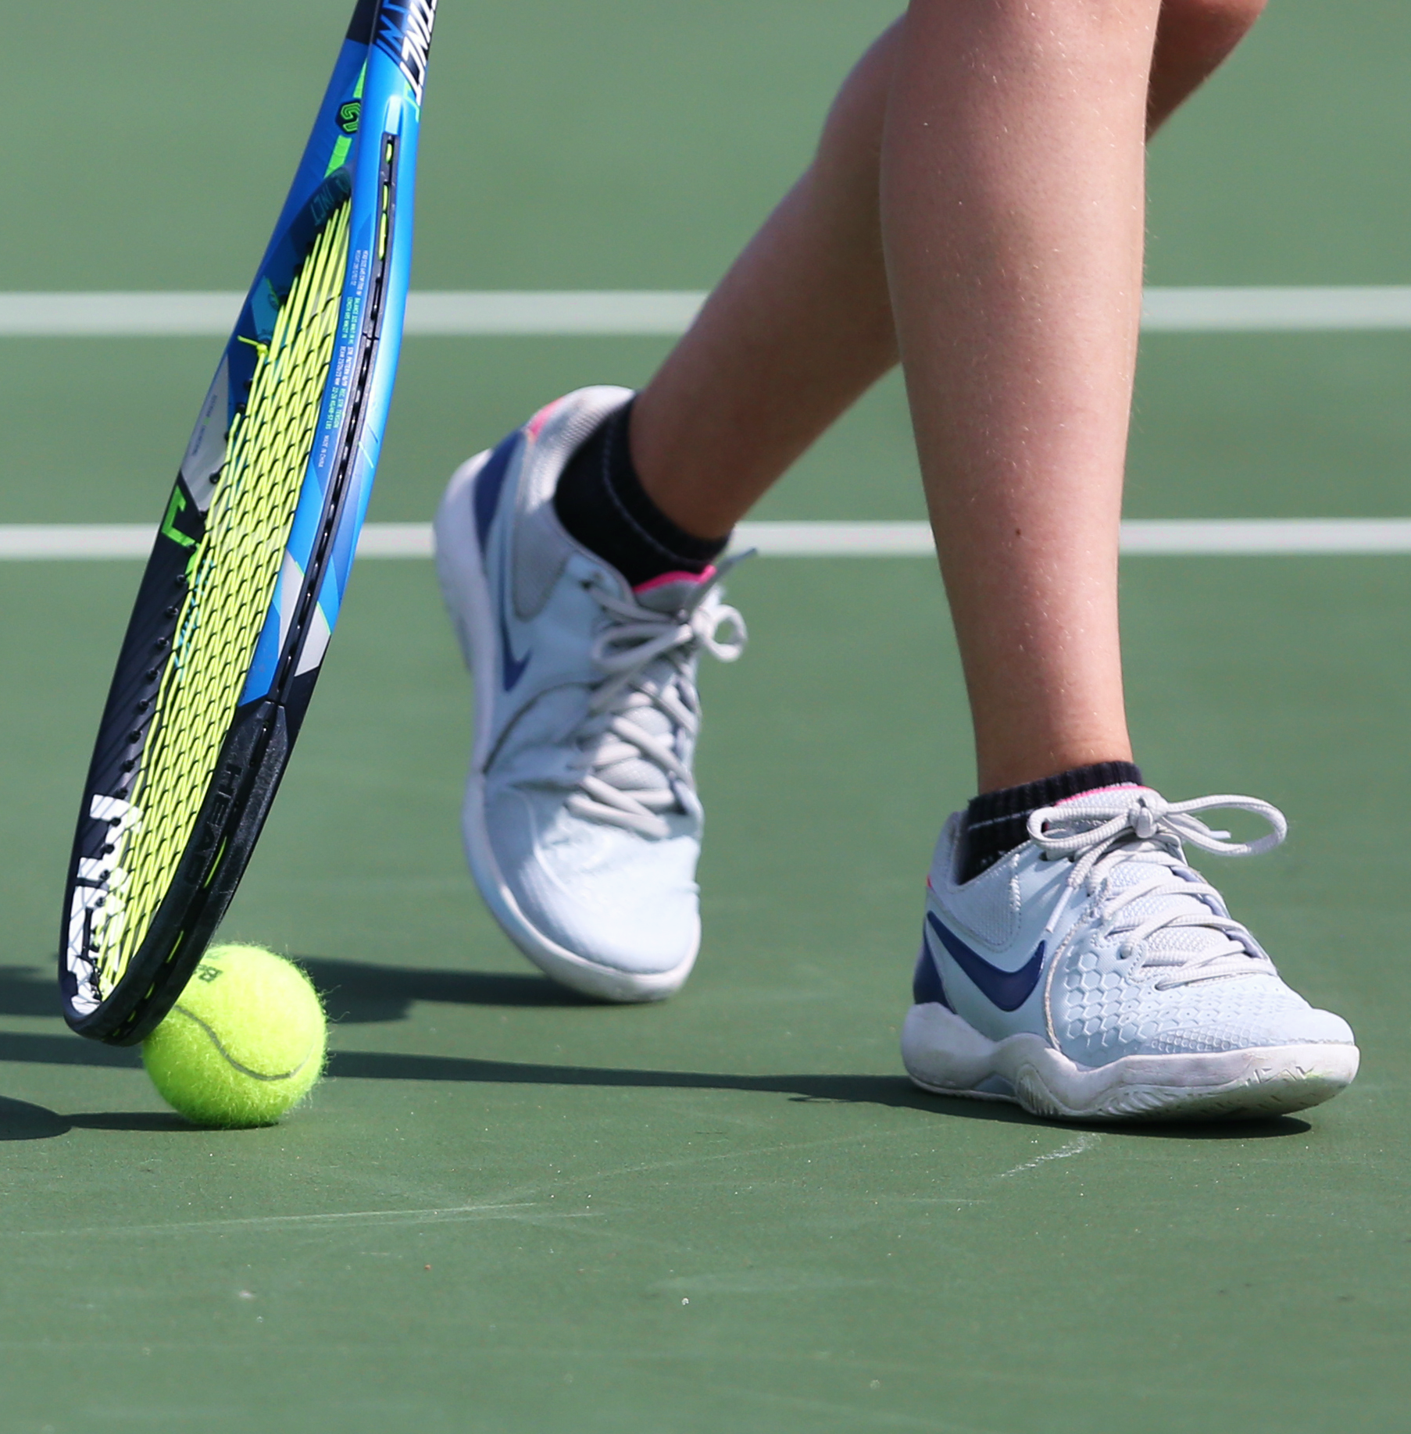
c2: Anti-doping legislation and guidance
Rule violations, consequences
and reporting
Research examples in tennis of
anti-doping rule violations
What are the physical, financial, social and other consequences of doping? How and why should doping be reported in tennis? | ?

Slide 27
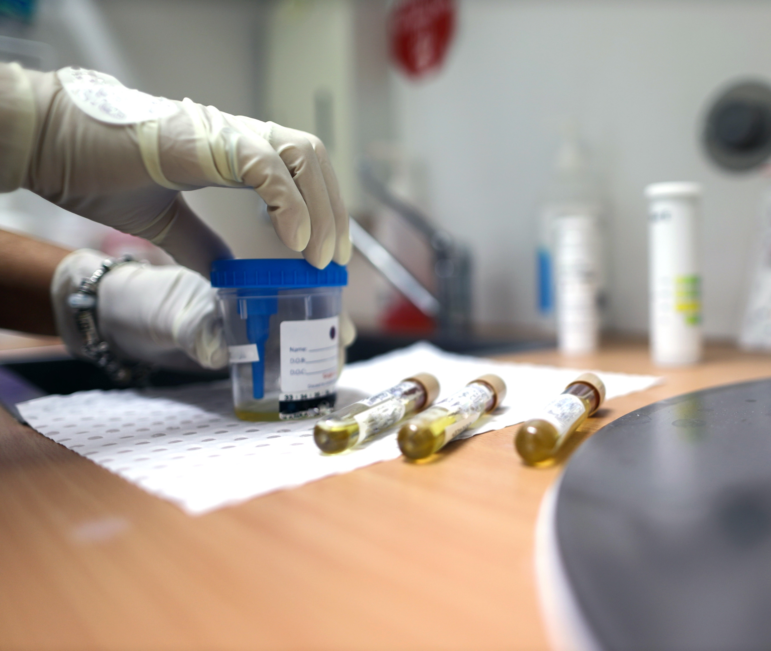
B3: Testing process
and whereabouts
Whereabouts: Anti-Doping organisations awareness of an athlete’s location in order to test them out-of-competition without advance notice.
The testing process:
Doping control officer / chaperone
Unannounced visit
Athlete’s availability and reporting
Tests: urine, blood, blood serum for athlete biological passport

Slide 28
D1: activities
Aerobic, anaerobic, muscular strength
& endurance and flexibility
Consider the different types of activity and when they
happen during a tennis match and during training:
Aerobic
Anaerobic
Muscular strength & endurance
Flexibility
Produce a diet and hydration plan to support a tennis player.

Slide 29

d1: Activities
timing
Pre-season
The period after the off-season.
When training is conducted and includes friendly matches.
mid-season
The middle of the sporting year.
Post-season
The period after the end
of a regular sports season.
Additional events may
be held.
Pre-event
Between 24 hours and 30 minutes before the sports event.
inter-event
The time in between events or in between an activity e.g. rest times and breaks.
Post-event
Up to 72 hours after the sports event is held.

Slide 30

D2: planning diets
Nutritional assessment tools
Nutritional assessment tools
Food diary
Food recall and frequency questionnaires
Body composition assessment
How can you use the above assessment tools to produce a diet and hydration plan for a tennis player? | ?

Slide 31
D2: planning diets
Appropriate for the activity and the individual
Diet and hydration plans
needs to be:
Appropriate for tennis
(time and intensity of the activity)
Appropriate for the selected
sports performer (age, gender, activity level)
assess the sports performer needs
Does the sports performer want to:
Gain or lose weight
Gain muscle
Gain or loss fat
Carbohydrate load

Slide 32
D2: planning diets
Contents of a nutrition and hydration plan
Nutrition
Macronutrients, Micronutrients, Fibre
Food Groups
Grains, Vegetables, Fruits, Oils, Dairy, Meat
Supplements
Caffeine, Creatinine Energy gels and bars, Protein shakes and bars
Consider the sources and availability of these types of nutrition, food groups and supplements Is the nutritional source natural or processed? Is the food type seasonal, is there another similar type available? Where in the country or world can you access the food types in your plan?

